Slide 1

Weather Data
and Next-Day PM2.5 Prediction
Evidence from Six Monitoring Stations
IS 507 Data, Stat, and Info Midterm Project
JingXuan Sun, Ta-Wei Peng, Che-Yueh Wu

Slide 2



Can weather improve tomorrow’s
PM2.5 prediction?
Six air-quality stations in Taiwan
Today’s PM2.5 and weather inform tomorrow’s average PM2.5
Decision: is the extra
weather data worth using?

Slide 3


Our Data
2021–2025 daily observations
Data sources
PM2.5: Taiwan Ministry of Environment
weather: CWA CODIS
station metadata: Taiwan Government Open Data
Stations
North: Tamsui, Zhongshan
Central: Zhongming, Nantou
South: Pingtung, Chaozhou
Unit of observation
One row = one station on one day
10,956 station-days before filtering

Slide 4


Data Challenges
PM2.5 daily mean required
at least 16 valid hourly readings
Checked missing values,
invalid symbols, and duplicate station-date rows
Matched each air-quality station to nearby weather observations
Pingtung used Linluo for temperature,
humidity, rain and Changzhi for wind

Slide 5

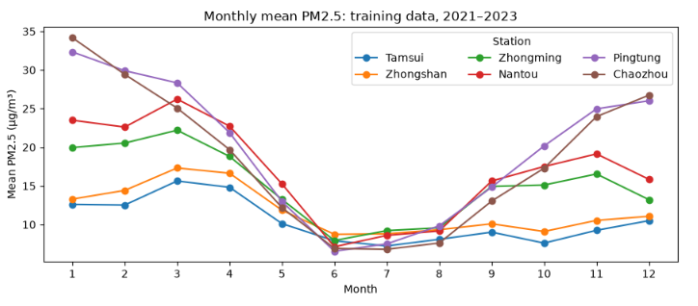

What We Saw in the Data
Monthly mean PM2.5 across six stations.
PM2.5 is generally lower in summer.
Levels differ across the six stations.
Training data
covers 2021–2023.

Slide 6
















Prediction and Evaluation
Prediction task
Use today's completed PM2.5
and weather observations to
predict tomorrow's average PM2.5.
2021-2023
2024
2025
Data split
Train
Validation
Final test
not yet examined
Evaluation metric
MAE:
mean absolute error.
Lower is better.

Slide 7


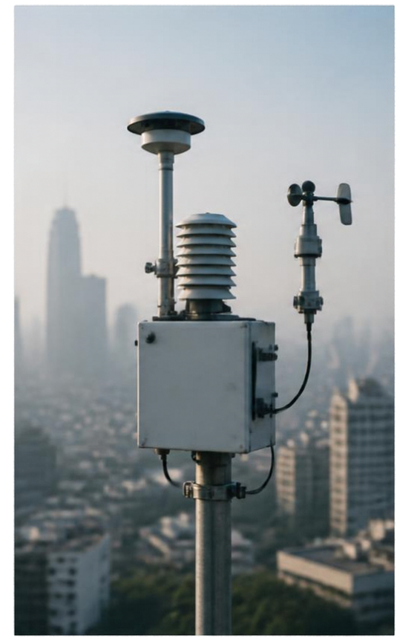


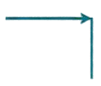




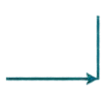
Three Models
01
Persistence
tomorrow equals today’s PM2.5
VS.
02
PM-only regression
today’s PM2.5 + station + target month
weather regression
versus
PM-only regression
Weather regression
03
PM-only inputs + temperature,
humidity, precipitation, wind speed

Slide 8


Overall Results
2024 validation results
Exact results for the same 2,181 observations
Model
Observations
MAE
RMSE
Persistence
2,181
4.131
5.844
PM-only regression
2,181
3.922
5.331
Weather regression
2,181
3.904
5.315
Adding weather reduced MAE by only
0.46%
versus PM-only

Slide 9







Results Vary by Station
Zhongshan
+0.10%
MAE improved at
3 of 6 stations
Nantou
+1.61%
Zhongming
+2.31%
Zhongming and Nantou
had the largest gains
Tamsui
−0.18%
Gains were small and inconsistent across locations
Pingtung
−0.47%
Chaozhou
−0.41%

Slide 10




What We Can Say So Far
Weather data gives a small overall improvement, but not at every station.
Both regression models underestimate high-PM2.5 days.
Next, test individual weather variables and evaluate the final model on 2025 data.
We do not recommend using weather data for all six stations yet.

